Slide 1


High Level Overview

Slide 2


AGENDA
Agenda
Introduction to HubOne – Credentials, Company and Team
The benefits of Cloud Technology and what it offers your practice
The Modern Practice
The Modern Practice Portal - Demonstration
Xero Practice Manger – Demonstration
The HubOne Experience
Business Case Example
Next Steps

Slide 3

INTRODUCTION
Founded in 2008
HubOne was Australia’s first cloud integrator
We are IT Specialists to the Accounting Industry
Over 50 years combined direct Accountancy and IT industry experience
WHO WE ARE
Develop and Integrate leading integrated cloud based Practice Management Systems
We provide extensive experience in the migration of business systems to Cloud Based Services
Provide industry best practices in Change Management, Training and ongoing Support
WHAT WE DO
Defining the Architecture
Overall Cloud Strategy
Migration, Implementation and Training
Ongoing Support and Updates
Partner Program
OUR VALUE

Slide 4


MANAGEMENT TEAM
CEO & Founder – Nick Beaugeard
An Enterprise IT Architect
Nick has worked within a number of global financial and government institutions ranging from Dimension Data, JP Morgan, BZW, Credit Suisse and the Singapore Government.
Nick has also worked directly in Microsoft Development Teams including the design team of Windows XP and has direct access to Microsoft C Level management as a result
Head of Accountants – Trevor Schoenmaekers
Accounting Partner with over 25 years experience in public practice
1st Certified Xero Partner in Australia
Wealth of Experience with Accounting Systems (MYOB, APS and Handy Soft)

Slide 5










WHAT WE HAVE ACHIEVED
ARN Winner Software Developer of the Year 2014
ARN Runner- Up Software Developer of the Year 2013
HubOne has taken over 150 Accounting Firms to the Cloud!
HIGHEST PARTNER LEVEL FOR:

Slide 6

CLOUD TECHNOLOGY
The benefits of moving your business practice to the Cloud :
Work anywhere
Decreased down time (server)
Reduced costs
Reduced administration
Productivity
Provides Enterprise Class Service at SMB pricing

Slide 7

One
Practice™
OTHER SERVICES
CORPORATE SECRETARIAL
SMSF
TAX
LEDGER AND ACCOUNTING
PRACTICE MANAGEMENT
DOCUMENT MANAGEMENT
REAL TIME COMMUNICATION
DESKTOP COMPUTING
WEBSITE AND MARKETING
EMAIL AND COLLABORATION
INTERNET, VOICE AND FAX

Slide 8
Other Services
Enable HR
Practice ignition
Corporate Secretarial
BGL CAS
SMSF
Class Super
SimpleFund
Tax
HandiTax
Workflow Max
One Practice™
Ledger and Accounting
Xero
Spotlight
Practice Management
Workflow Max
Xero Practice Manger
Document Management
Office 365
Modern Practice Portal
Scanned Document Manger
Real Time Communication
Office 365
Desktop Computing
Windows Intune
Ultimate Workstation
Website and Marketing
Office 365
MailChimp
Email and Collaboration
Office 365
Internet, Voice and Fax
Existing Provider, Mobile,
Vertiro

Slide 9
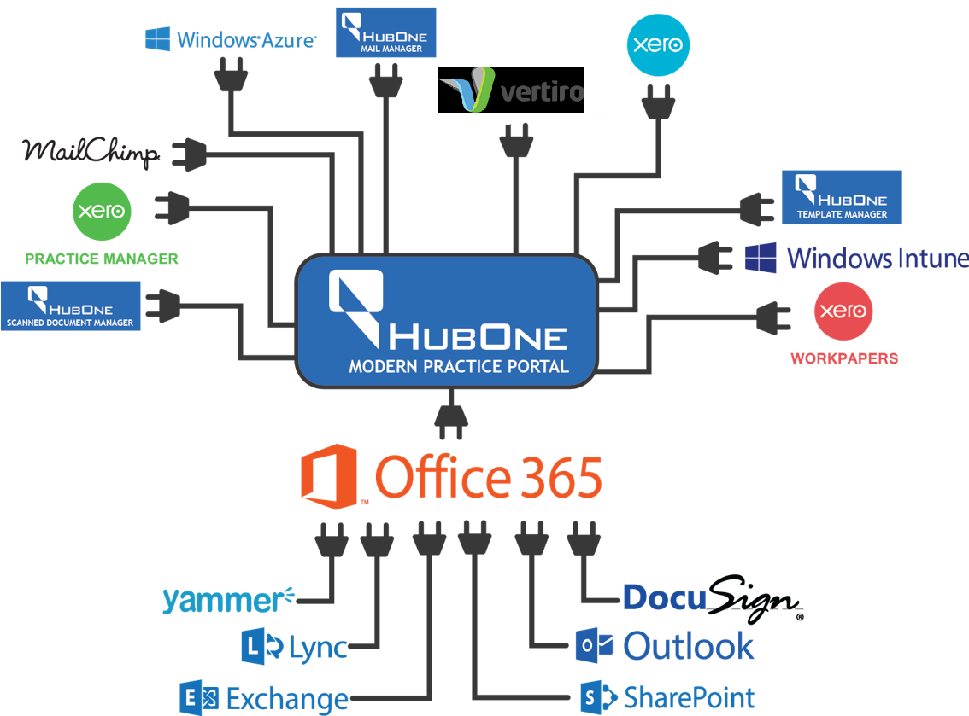
OnePractice™

Slide 10



KEY FEATURES / BENEFITS
For your Practice:
Total integration with Xero Practice Manager
Easy Debtor Management
Simple Bank Reconciliation
BAS – 3 Click Process
Better Payroll
Employee Portal
Leave
Payslips
Practice Management:
Client Manager
Xero Integration
Better workflow management
Ideal for upfront pricing
Improved efficiencies – up to 35%
Less time for Partner Billing
Total integrated process:
Lead
Quote / Estimate
Job
Invoice
Ledgers & Workpapers:
Import journals
Single ledger
Simple report packs
Client Queries e-Portal
Simple concept focusing on
efficiency:
Approval Process
Materiality
Analytical review

Slide 11



KEY FEATURES / BENEFITS
Cloud Server:
Reduced operating costs
Legacy software in the cloud
Highest Security Standard
Single sign on
Desktop Management:
Patch Management
Telemetry
Virus Protection
Inventory
Remote control
Software asset management
Email & Document Management:
Simple subscription
Single login
No licencing issues
No Microsoft audit risk
Anywhere access
Legal hold
Version control
Office Suite

Slide 12



KEY FEATURES / BENEFITS
Scanning and Filing:
Complete integration with database
Automatic filing of documents
OCR recognition
Learning mode
Automatic workflows
Templates and Documents:
Complete integration with database
All XPM Fields
Automatic filing
Simple to use
Easy to create templates
HubOne working directly with UTS, CPA & CA’s to provide free ongoing content
Email Management:
Complete integration with database
One click filing
Auto contact filing
Easy to use

Slide 13
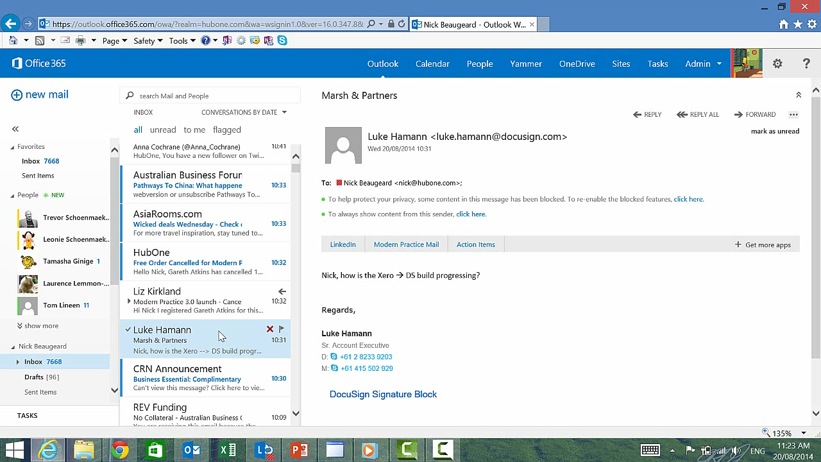
Mail Man

Slide 14
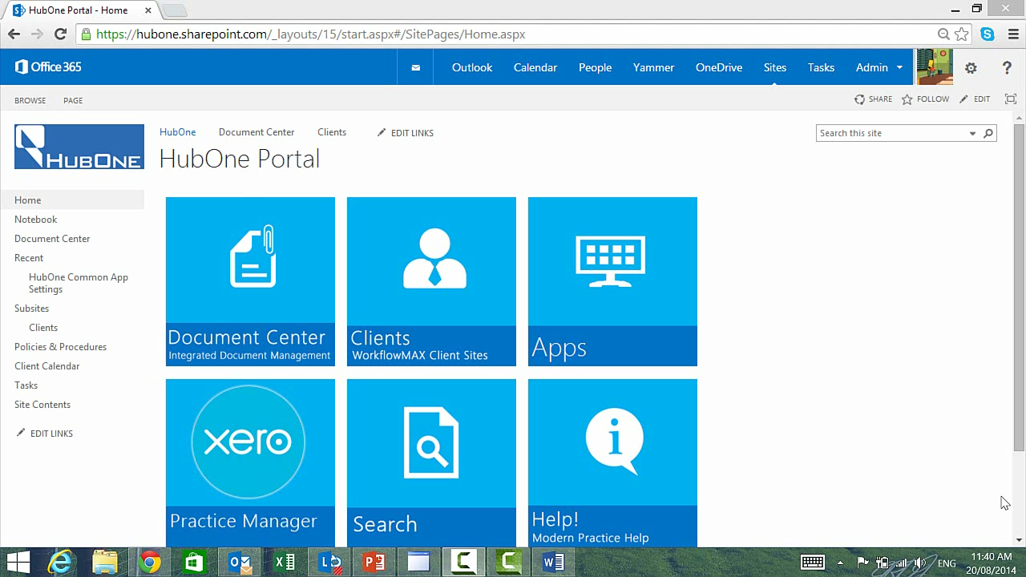
Template Manager

Slide 15
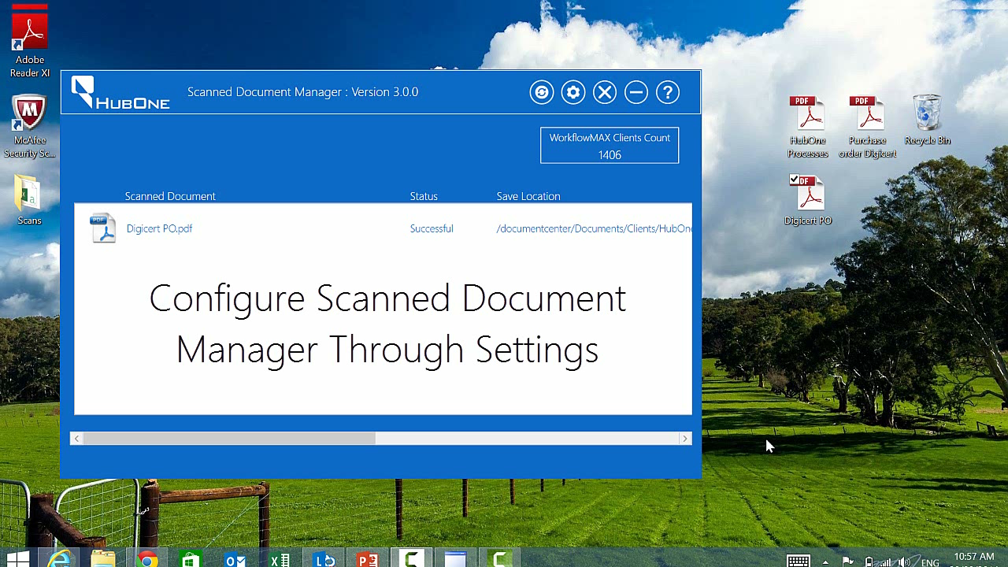
Scanned Document Manager

Slide 16
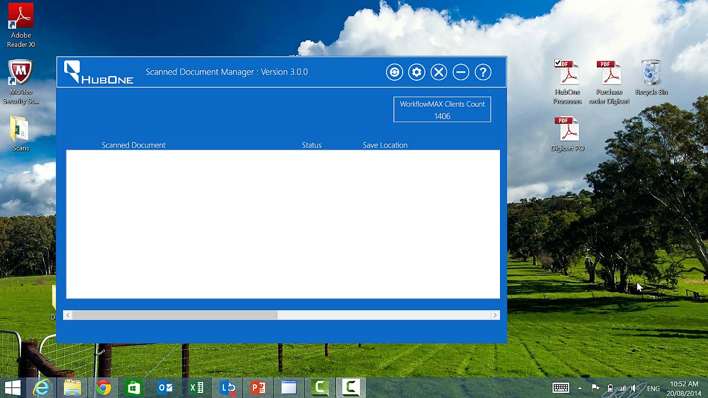
Scanned Document Manager

Slide 17

Xero Practice Manage Demonstration
Xero Practice Manager
Dashboard
Productivity Visuals
Job Management
Client and Data Base Management (single source of Truth)
Tax
Lead Manager

Slide 18
DESKTOP SUPPORT PROVIDED
Desktops
Anti Malware
Patch Management
Inventory
Remote Control
Software Asset Management
Telemetry

Slide 19
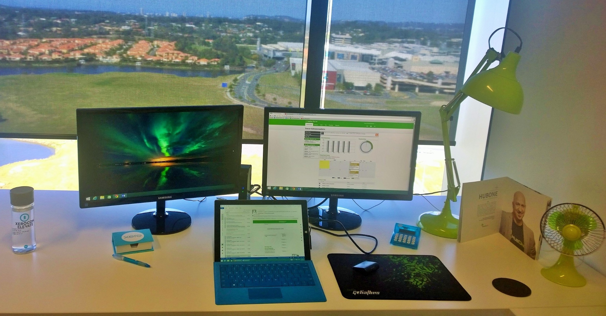
EXAMPLE OF A CLOUD WORKSTATION

Slide 20
BUSINESS CASE EXAMPLE:
Based on 20 users & 3 Servers
IT Costs:
IT Support Costs $2,500 p/m
IT Maintenance & Upgrades $875 p/m (Additional 35%)
Current Practice Management & Tax Software:
MYOB AE $3,000 p/m
Document Management Software:
MYOB Doc Manager $600 p/m
How Now $750 p/m
PDF Manager:
MYOB PDF Manager $150 p/m
Email:
Exchange Server (amortised over 3 years) $250 p/m
Microsoft Office Biannually $667 p/m
Other Incidentals:
Back Up Tapes $79 p/m
Anti-virus $60 p/m
Terminal Server Cost: $275 p/m
Server Costs Amortised over 3 years: $1,250 p/m
Electricity Costs Servers:
@ $0.40 per hour $876 p/m

Slide 21
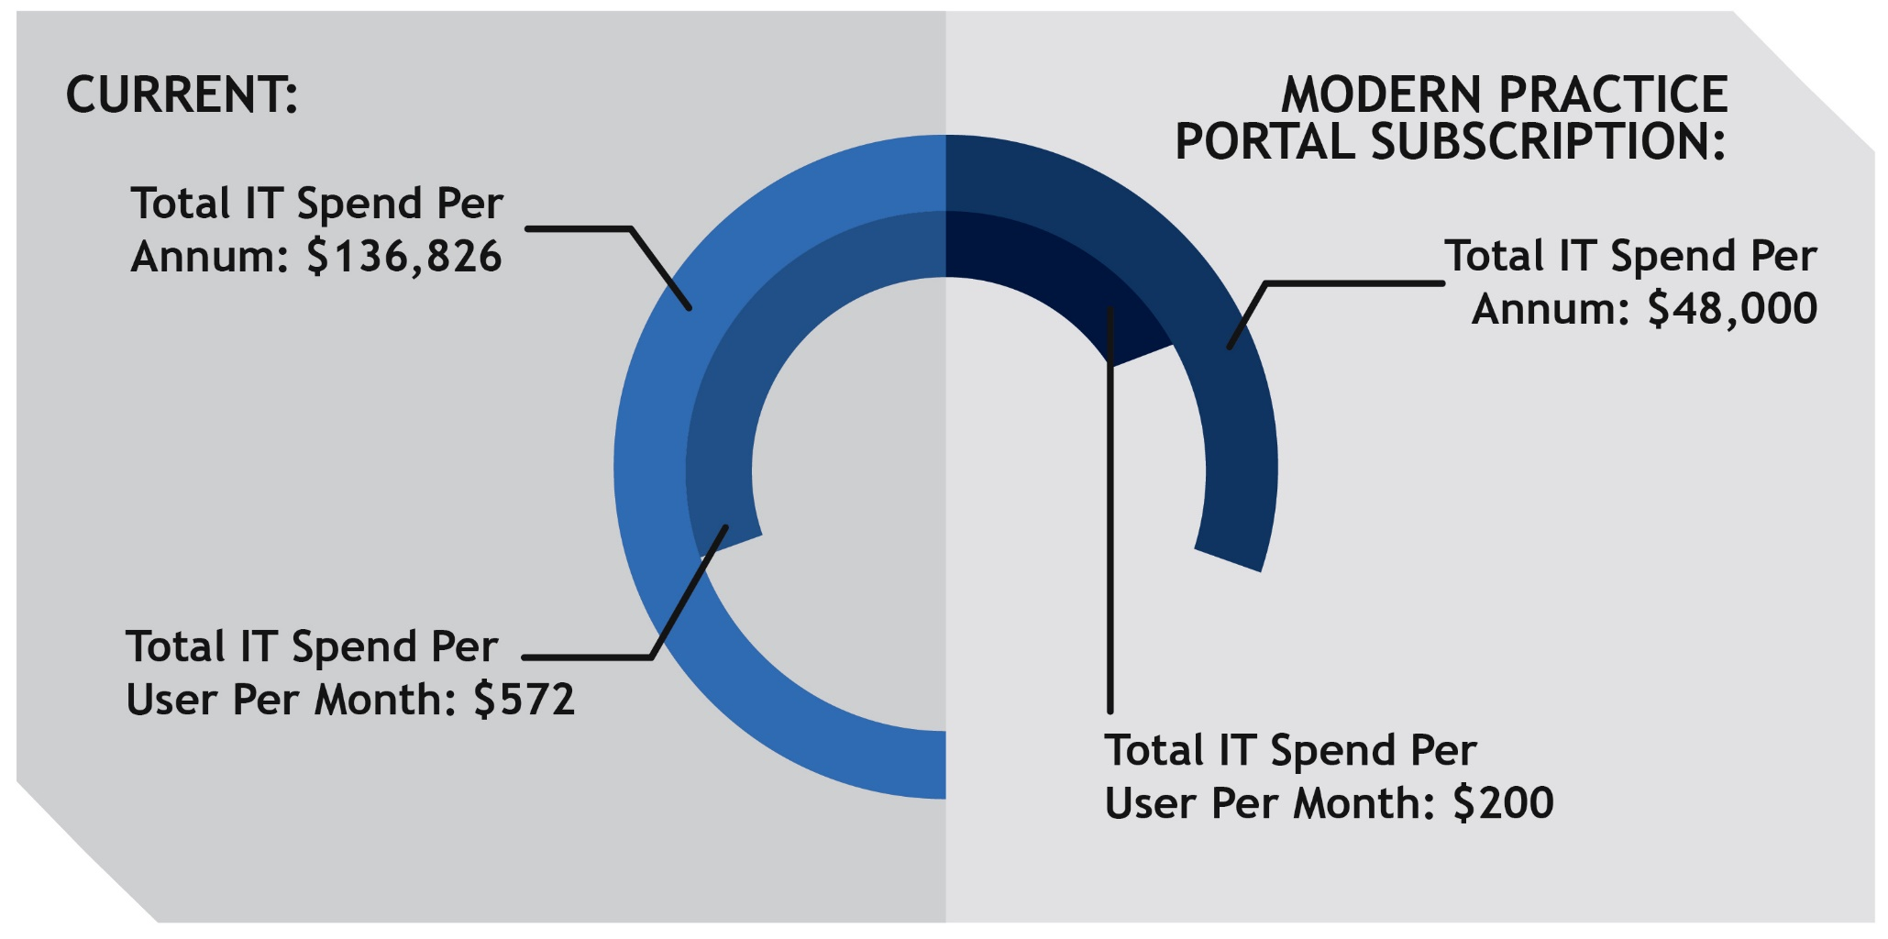
BUSINESS CASE EXAMPLE:
Based on 20 users & 3 Servers
Total IT Spend Per Annum: $153,380

Slide 22

BUSINESS CASE EXAMPLE:
Based on 20 users & 3 Servers
If we can save one hour per week, per person from efficiencies through utilising the Modern Practice – that’s an additional $150 per user per month in savings or $36,000 per annum.
HOW MUCH ACTUAL TIME DO YOU HONESTLY THINK YOU CAN SAVE?
Consider the opportunity cost if we applied an average hourly rate of $120 across the team.
Based on one hour per week in down time or efficiencies that’s $120,000.

Slide 23
MODERN PRACTICE PORTAL SUBSCRIPTION
Saving your business ALMOST 20% EVERY MONTH
THE FOLLOWING ITEMS ARE INCLUDED IN THE SUBSCRIPTION
Item
Value (Per User Per Month)
Microsoft Office 365 E3
$28.15
50Gb Mailbox per user, unlimited archive, 5 licenses of Microsoft Office Professional Plus, special accounting features.
Microsoft Windows Intune
$11.00
Desktop management, anti-virus, patch management and alerting.
Single Sign on for Common Cloud Applications
$10.00
Manage logins for Xero and common social applications at an organisational level
HubOne Gold Support
$50.00
4 Business hour response with telephone support.
Moves, Additions and Changes Consultancy
$30.00
Use our team to add new hardware, printers, networks and devices or make changes
Scanned Document Manager
$25.00
Automatically file paper documents into the correct location.
Modern Practice Portal
$9.95
One click access to applications, accounting management including templates, policies, mailing register, document version control and Xero Practice Manager Integration.
Modern Practice Portal Outlook Integration
$5.95
Automatically file emails and attachments against the specific client.
Professional Website, Hosting and Design
$25.83
Development and hosting of a professional website for your practice.
Access to HubOne IT Consulting team for additional project work.
$50.00
Equivalent to 3 hours per user per year. Unlimited when subscribing.
Total Value
$245.88
Pay just $200 per user per month

Slide 24
MODERN PRACTICE PORTAL SUBSCRIPTION
Saving your business 73% OFF OUR CURRENT COMPETITIVE PRICES
IMPLEMENTATION & TRAINING
Item
Value
Document Migration
$2,500
Includes copying data from existing server to HDD, shipping HDD to cloud environment, manipulation and
uploading of data onto the Modern Practice Portal.
Modern Practice Portal Installation and Configuration
Includes implementation of the Modern Practice Porta, and configuration with Xero Practice
Management and set up for your business.
$2,500
Modern Practice Portal Training (Champion and Team)
Includes individual training for your practice champion and team training including access to ongoing
computer based training.
$1,600
Office 365 Migration
$3,750
Seamless migration of calendars, contacts, emails, domains and more
Xero Practice Manager Implementation & Training
Advise on how to extract client data from your current system and how this should be transferred into a spread sheet represented in a .CSV format for upload to Xero Practice Manager; Upload client data into Xero Practice Manager and linking this through to your Xero file; Provide a XPM manual; Provide job templates, quote templates and lead template; Review of your accounting procedures and advice on how Xero Practice Manager can work functionally for your business; 4 hours training for your team (we recommend a maximum of 10 users for web based training and maximum of 15 users for on site training for this session); 3 hours of 1 on 1 training with a nominated champion; Additional 1 hour training session on Report Builder with the champion; 1 hour post implementation review to be held one month after team training; and Implementation Assistance until sign off of Project objectives.
$8,450
Total Value
$18,800.00
Pay just $5,000 up front

Slide 25

THE HUBONE EXPERIENCE
Anticipated total time taken from engagement through to final implementation – 3 months
HubOne constructs your new Practice Management System with no impact on your current workflows
Everything is constructed on a shadow site and is waiting for you to be ready to deploy!

Slide 26



THE HUBONE EXPERIENCE
Office 365 & Intune
Email
Desk side
Practice Studio
Establish
Migrate
Modern Practice
Implement
Migrate
SharePoint and Lync
Train
Train
Support
Legacy Apps
Package
Migrate
Release
Telephony
Analyse Bill
Recommend
Implement
Team Champ
HubOne

Slide 27

NEXT STEPS
Account Manager discussion Q&A
Product Demonstration – HubOne Head of Accountants Trevor Schoenmaekers
On-boarding Client Information Pack
Individualised Quote
Product Overview Documents
Implementation Process
Service & Support Agreement
Next Steps
Booking Integration & Training Dates

Slide 28

THANK YOU
Thank you for considering HubOne as your Practice Management Provider.

